Slide 1

PES’s Modern College of Engineering, Shivajinagar, Pune-5. Department of Electronics and Telecommunication 2019-20
Project Title :- Automatic Fruit Sorting System Using Raspberry-Pi
Names of the students
1. Saurabh S. Parve
2. Rajashri B. Gharde
3. Swapnali M. Undale
Name of The Guide :- Prof. Mr. R. Sahu
Automatic Fruit Sorting System Using Raspberry-Pi

Slide 2

PES’s Modern College of Engineering, Shivajinagar, pune-5. Department of Electronics and Telecommunication
Overview :
Introduction
Literature Survey
System Specifications
Block Diagram
Hardware Design
Software Design (Flow Chart or Algorithm)
Result (Photo / Audio-Visual / Video Results)
Applications
Future Scope
Conclusion
References
Automatic Fruit Sorting System Using Raspberry-Pi

Slide 3
PES’s Modern College of Engineering, Shivajinagar, pune-5. Department of Electronics and Telecommunication
1. Introduction
Every system is getting automated
Manual sorting is the conventional approach preferred by industries.
Different parameters are unable to sort on same line traditionally.
The the proposed system is develop with low time consuming and effective approach for sorting of fruits.
Automatic Fruit Sorting System Using Raspberry-Pi

Slide 4
PES’s Modern College of Engineering, Shivajinagar, pune-5. Department of Electronics and Telecommunication
2. Literature Survey
Sr. No. | Author | Paper Title | Method
1. | R. Swarna Lakshmi, | Review of fruit grading systems for quality inspection | Imaging spectroscopy, Fruit grading, Fuzzy Inference system, Neural Networks
2. | Krithika Jayasankar | Fruit Freshness detection using Raspberry Pi | Raspberry Pi, Digital Image Processing, Embedded. Computer vision
3. | Jyoti Jhawar | Orange Sorting by Applying Pattern Recognition on Colour Image | Pattern Recognition; Color Image Processing.
Automatic Fruit Sorting System Using Raspberry-Pi

Slide 5
PES’s Modern College of Engineering, Shivajinagar, pune-5. Department of Electronics and Telecommunication
Sr. No. | Author | Paper Title | Method
4. | Güray Tonguc | Fruit Grading Using Image Processing Technique | Machine vision, Fruit classification
5. | Trupen Meruliya | Image Processing for Fruit Shape and Texture Feature Extraction – Review | Texture feature extraction
6. | Susovan Jana | Automatic Fruit Recognition From Natural Images using Color and Texture feature | Grey-level Co-occurrence matrix ,support vector machine
Automatic Fruit Sorting System Using Raspberry-Pi

Slide 6
PES’s Modern College of Engineering, Shivajinagar, pune-5. Department of Electronics and Telecommunication
3. System Specifications
Operating Voltages:
Raspberry pi : 5 V
Servo motor : 3V-7V
Dc Motor 12V 150 RMP
Camera : 5Mp
Mechanical Enclosure
100 cm X 30cm X 30cm
Automatic Fruit Sorting System Using Raspberry-Pi

Slide 7
PES’s Modern College of Engineering, Shivajinagar, pune-5. Department of Electronics and Telecommunication
Size Sort
4. Block Diagram
Size Sort
Raspberry-Pi with Camera Module and IR Sensor
High-Quality Apple
High-Quality Orange
Secondary Conveyor Belt
Conveyor Belt Servo Motor Servo Motor
Rack and Pinion System
DC Motor
Gateway
Low-Quality Apple
Low-Quality Orange
Figure 4.1: Block diagram of the automatic fruit sorting system.
Automatic Fruit Sorting System Using Raspberry-Pi

Slide 8
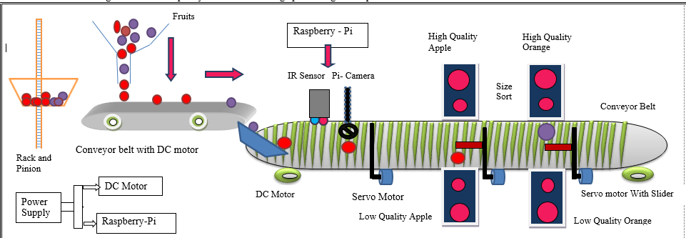
PES’s Modern College of Engineering, Shivajinagar, pune-5. Department of Electronics and Telecommunication
4.2 Structure Diagram
Figure 4.2: Stuctural diagram of the automatic fruit sorting system.
Automatic Fruit Sorting System Using Raspberry-Pi

Slide 9
High quality
fruits
Low quality fruits
size wise sorting
IR Sensor
Rack and Pinion
Servo Motor//
Controlling Parameter
DC Motor
continuously
Running
Raspberry
pi
Servo Motor

Slide 10
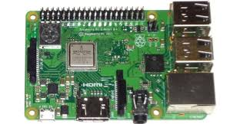
PES’s Modern College of Engineering, Shivajinagar, pune-5. Department of Electronics and Telecommunication
5. Hardware Design
5.1 Raspberry pi Specification:-
CPU: 700 MHz ARM1176JZF-S
Memory: 512mb, USB ports: 4
Output: resolutions
from 640×350 to 1920×1200 plus
Power Source: 5V Micro USB
Size: 85.60 mm × 56.5 mm
5.2 Mechanical Enclosure
100 cm X 30cm X 30cm
Automatic Fruit Sorting System Using Raspberry-Pi

Slide 11
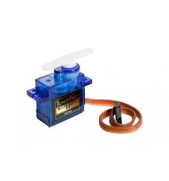
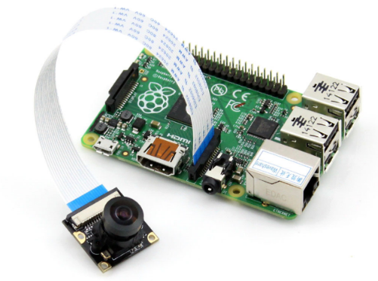
PES’s Modern College of Engineering, Shivajinagar, pune-5. Department of Electronics and Telecommunication
5.3 Servo Motor (Tower Pro SG90 )
Size : 23x11x29 mm
Voltage : 3V to 6V DC
Speed : 0.12 sec/60 (at 4.8V)
5.4 Camera module
Focal Length : adjustable
Sensor best resolution : 1080p
Provides 3.3V power output
Dimension: 25mm x 24mm
Automatic Fruit Sorting System Using Raspberry-Pi

Slide 12
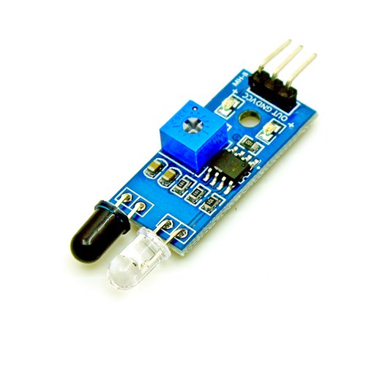
PES’s Modern College of Engineering, Shivajinagar, pune-5. Department of Electronics and Telecommunication
5.5 DC Motor
Operating Voltage :12V
RPM :120 RPM
5.6 IR sensor
Operating Voltage: 3.0V – 5.0V
Detection range: 2cm – 30cm
Active output level: Outputs Low logic level
when obstacle is detected
On board Obstacle Detection LED
indicator
Automatic Fruit Sorting System Using Raspberry-Pi

Slide 13
PES’s Modern College of Engineering, Shivajinagar, pune-5. Department of Electronics and Telecommunication
START
6. Software Design
(Flow Chart)
IR initialized and detect obstacle and image capture by Pi-Camera
Image acquisition
Image segmentation
Training Set
Testing Set
Feature Extraction
Feature Extraction
Train KNN Classifier
Test
Output
Sorting with quality and size
Automatic Fruit Sorting System Using Raspberry-Pi
STOP

Slide 14
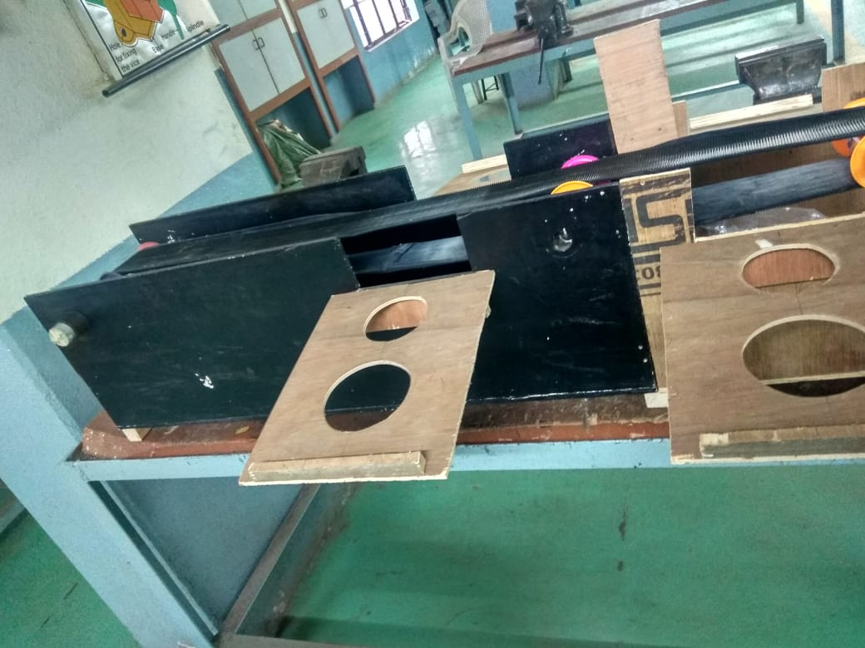
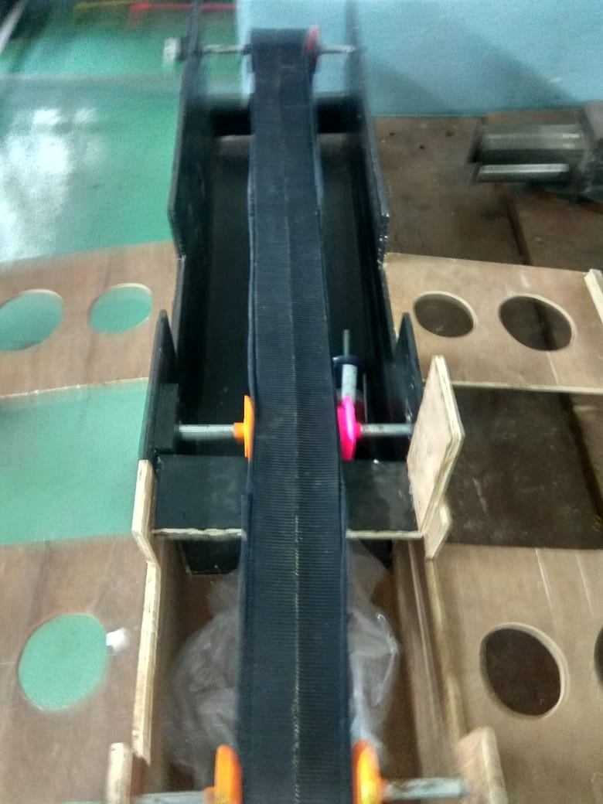
PES’s Modern College of Engineering, Shivajinagar, pune-5. Department of Electronics and Telecommunication
7. Result (Photo / Audio-Visual / Video Results)
Fig.7.1 Side View Fig 7.2 Top View
Automatic Fruit Sorting System Using Raspberry-Pi

Slide 15
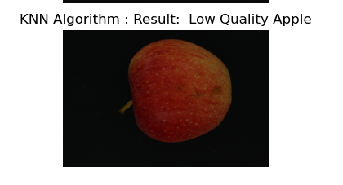
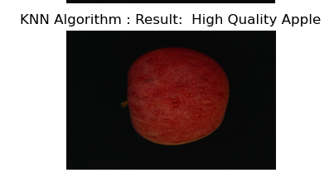
PES’s Modern College of Engineering, Shivajinagar, pune-5. Department of Electronics and Telecommunication
7. Result (Photo / Audio-Visual / Video Results)
V
Figure 7.3:- Result of Figure 7.4:- Result of
high-quality apple low-quality apple
Automatic Fruit Sorting System Using Raspberry-Pi

Slide 16
PES’s Modern College of Engineering, Shivajinagar, pune-5. Department of Electronics and Telecommunication
8. Applications
Proposed system we can use it in any industrial use where sorting on the basis of dimension is main concern.
Use for sorting of desirable color of fruit and (e.g. raw and ripen fruit will be sorted)
Can be used in food processing units like juice and jelly production units
We can also use it for sorting of vegetables.
Automated fruit sorting is speedy, inexpensive, safe and accurate.
Automatic Fruit Sorting System Using Raspberry-Pi

Slide 17
PES’s Modern College of Engineering, Shivajinagar, pune-5. Department of Electronics and Telecommunication
9. Future Scope
The system can be improved by making some changes in the
program and components. Some suggestions are :
Add a load cell for measurement and control of weight of the product
A counter for counting the number of products
Use of IOT system.
Automatic Fruit Sorting System Using Raspberry-Pi

Slide 18
PES’s Modern College of Engineering, Shivajinagar, pune-5. Department of Electronics and Telecommunication
10. Conclusion
This proposed system sort the fruit according to size and quality at a time.
KNN Algorithm is active algorithm for fruit sorting.
The recognition of fruit is accurate up to 90%
Provides cost effective, low time consuming and technically simple approach for sorting of objects.
Automatic Fruit Sorting System Using Raspberry-Pi

Slide 19
PES’s Modern College of Engineering, Shivajinagar, pune-5. Department of Electronics and Telecommunication
11. References
R. Swarna Lakshmi, B. Kanchanadevi 2014. “Review of fruit grading systems for quality inspection”. IJCSMC, Vol. 3, Issue 7, 615-621
Krithika Jayasankar, Karthika B, Jayashree T, Deepalakshmi R, Karthika G” Fruit Freshness detection using Raspberry Pi” International Journal of Pure and Applied mathematics Volume 119 No.15 2018, 1685-1691
Jyoti Jhawar “Orange Sorting by Applying Pattern Recognition on Colour Image” International Conference on Information Security and privacy(ICISP2015),11-12 December 2015, Nagpur, INDIA.
Güray Tonguc, Ali Kemal YAKUT “ Fruit Grading Using Image Processing Technique” article January 2009
Trupen Meruliya, Parth Dhameliya Image Processing for Fruit Shape and Texture Feature Extraction – Review International Journal of Computer Applications(0975-8887) Volume 129- No 8, November 2015.
Susovan Jana, Saikat Sasak, Ranjan Parekh “Automatic Fruit Recognition From Natural Images using Color and Texture feature” 2017 Device for Integrated Circuit(devIC) 23-24 March 2017 IEEE India.
Manali R. Satpute and Prof. Sumati M. Jagdale “Color, Size, Volume, Shape and Texture Feature Extraction Technique for Fruits – a review: IRJET Volume 3 issue 4 Apr 2016.
Woo Chaw Seng and Seyed Hadi Mirisaee. "A New Method for Fruit recognition System" 978-1-4224-4913-2 / 2009 IEEE
Seema, A. Kumar, and G.S. Gill. “Automatic fruit grading and classification system using computer vision – A review” 978-1-4799-1734-1/2015 IEEE
Automatic Fruit Sorting System Using Raspberry-Pi

